Slide 1
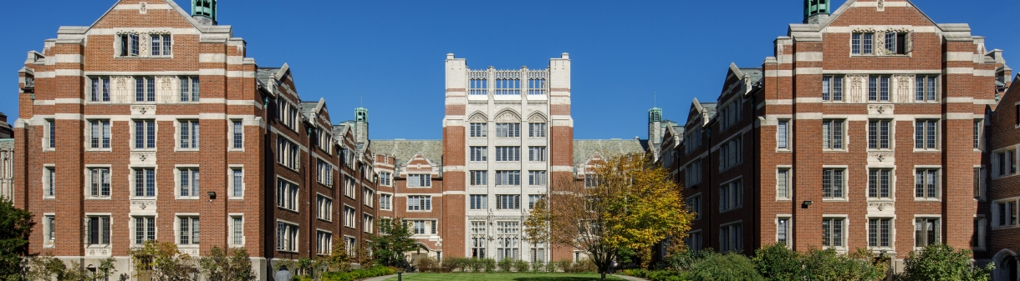
AI Fight Hub: Better understanding
AI Policy and Impact at Wellesley
Karrington, Gloria, Zinuo, Belle
2024
Notes:
zinuo

Slide 2
Motivation
Heard students being falsely accused in our daily life.
Stakeholders don’t know full impact of the accusations
Hub for resources and active communication.
Map the scope accusation and individual experience with AI policies at Wellesley
Student Experience
AI Fight Hub
Introduction
Notes:
Zinuo

Slide 3
Research Direction
Professors’ confusion and expectations
Mapping the scope of False AI Accusations
Student Experience
and Demand
Mapping the space of experiences
Writing Tutors and Honor Code Council Resources
Fostering active conversation
AI Fight Hub
Introduction
Notes:
K
Briefly (a sentence for each)

Slide 4

Faculty
10 students
5 falsely
accused
2 Writing tutors
1 Chief Justice
18 Interviews, 2 weeks
AI Fight Hub
Data & Methods
Notes:
K
43 s
Collected data from students and professors
Questionnaires sent out
Anonymous form
Interviews with students and faculty to learn more about their experience with AI from their specific point of view
Medium scale survey (~50 participants) ask students their experience with AI usage accusations
Information about class year, race, and any honor code council hearings. These questions were optional to answer.

Slide 5
Qualitative
Our goal:
To understand different experiences from students and stakeholders, not to quantify and categorize them.
Analysis
AI Fight Hub
Data & Methods
Notes:
Process:
30 minute interviews
detailed notes
team discussion
collective understanding

Slide 6
Students…
Unclear policies
Gen-AI tools
Stress from
Want more
Want more trust
=Anxiety
for learning
Accusations
Communication
with professors
AI Fight Hub
Findings & Analysis
Notes:
B
Clear and defined AI Policy
Unclear policies can create anxiety
Students use Gen-AI tools as a supplemental learning tool
Gen-AI tools can be counterproductive as it takes many tries to get a quality response
Being accused of using AI is an extremely stressful experience
Want more trust with professors

Slide 7
Writing
Receive high quality instruction
Student resource
Preparedness
AI cannot write well!
Confusion from first years
Tutors
AI Fight Hub
Findings & Analysis
Notes:
B
Receive high quality instruction on Gen-AI tools and how to support students
Can provide support to students advocating for their work
Students that come to writing tutors don’t really use AI tools
AI tools are not good writers
Ambiguity of AI policies creates lots of confusion, especially for first years

Slide 8
Knowledge and policies vary
NO desire to
police students
Some benefit but
unclear student usage
Professors
Inaccurate checkers but still used
Interview
Want to support
student learning, will
talk w/students first
Not a new phenomenon
AI Fight Hub
Findings & Analysis
Notes:
B
Have varied experience and understanding of Gen-AI Policies
Think that these tools have some benefit for learning but it’s unclear if students are using it the right way
Decide their AI policy based on departmental policies and what others are doing
Have NO desire to police students
Have a general understanding of the inaccuracies of Gen-AI checkers but some still use it
Try to talk to students first after suspecting a violation of their AI policy

Slide 9
Honor
Administrative changes:
As a student resource:
Most recent update and publication Fall 2023
No blanket policy
“[U]nauthorized use of ChatGPT or other artificial intelligence (AI) program”
Student meet with council to explore different options
Students can directly reach out to HCC
Initial student charge ≠ immediate HC Violation
Council
AI Fight Hub
Findings & Analysis

Slide 10
Discussions and Implications
What to Stop
What to Start
Resource Hub
Report Map
Policing
Open conversation
Summary of Interviews
“No AI”
Utilize resources
Recommendations to the community
Support for Students
Resources for Professor
Info about external resources
AI Fight Hub
Discussion & Implication
Notes:
Gloria
ChatGPT is AI, but AI is not ChatGPT. Our group had many thorough discussions about what exactly the result of our project would be. What was the one solution? But as you can guess there is not just one solution. as mentioned prior we are in the process of creating a resource hub for students and professors to start facilitating this learning, but this is just the beginning. we realize that the goal in the results of this project truly lie in conveying to the Wellesley Community what exactly was uncovered. An efforts to destigmatize conversation surrounding Ai and specifically generative AI, we want our Hub to be used as a starting point. Some students are being falsely accused, some students want to know how this can potentially be used, professors want to know how students are potentially using it, students are scared, and professors are curious but nervous. so how do we bridge this gap, by learning and knowledge sharing. Isn't this what we all came to Wellesley to do, to learn? so how is it productive if we're policing students (in some cases) as opposed to engaging with them and meaningful discussions. we want to continue to build trust within the Wellesley community. between students and professors between faculty and students between students and students between students.
Stop
Policing
“No AI” - general policies like this can be very misleading

Slide 11
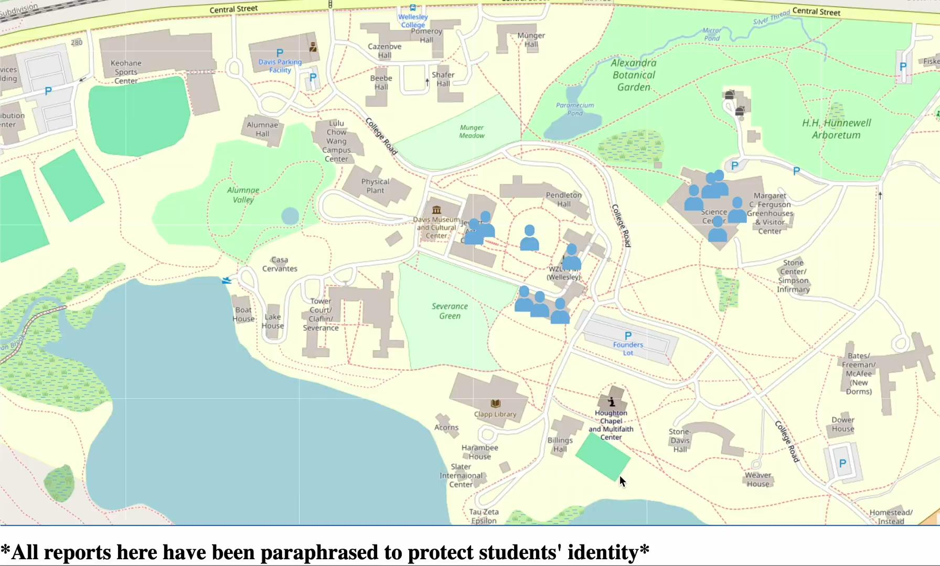
AI Fight Hub
Report Map
Notes:
G
it’s a small number but don’t we care
how many cases are considering too much for use to consider this an use
start with research direction
explicitly state the deliverables
first slide

Slide 12

Empathy and building trust
Notes:
Gloria
Let's practice some empathy and be trusting of each other, let's assume that we are all here because we want to learn. when it comes to AI and generative, he ultimate goal for us here was to hear students' stories and begin to figure out how we can support them, so do just that let's work together to figure out ways we can support each other.

Slide 13
Think about…
What does an honest conversation between professors and students around using Gen-AI tools look like?
How can we build trust as new technologies restructure the way we interact with each other?
What are lessons that we can learn from how we’ve navigated older technologies such as Wikipedia or the spell checker than we can learn from today?
What is the purpose of the classroom environment at Wellesley? Why are we here?
AI Fight Hub
Findings & Analysis
Notes:
B
Clear and defined AI Policy
Unclear policies can create anxiety
Students use Gen-AI tools as a supplemental learning tool
Gen-AI tools can be counterproductive as it takes many tries to get a quality response
Being accused of using AI is an extremely stressful experience
Want more trust with professors

Slide 14

Thank You
Professor Takis, Professor Dougherty, Sarah Block, Professor Eldrett, Professor Rodensky, Professor Chudy, Grace, Phobe, Emily, Juliana, and other anonymous interviewees and survey participants

